Slide 1
A model for simulating gas bubble entrainment in two-phase horizontal slug flow: a discussion
Daniel Cruz

Slide 2
Introduction
In slug flow, gas is often entrained from the large elongated gas (often called Taylor) bubble
into the liquid slug and this is thought (if not taken for granted) to have a significant effect on the slug behaviour. It is hence desirable to model this phenomenon in order to understand its importance
as well as to improve the accuracy of the prediction of slug characteristics. The present
study is focused on the modelling of this gas bubble entrainment (also referred to as ‘‘aeration’’)
and its effects on liquid slugs in horizontal gas–liquid flow in pipes.

Slide 3
Introduction
The most common approach for incorporating gas entrainment in slug flow calculations is the
use of empirical correlations for the dispersed bubble void fraction in the slug. They correlated their
results in terms of the mixture velocity UM only as:
Jepson
(1987).
Gregory et al. (1978)
Malnes (1982)

Slide 4
The model: M. Bonizzi, R.I. Issa
International Journal of Multiphase Flow 29 (2003) 1685–1717
It is easy to show (Bonizzi, 2003) that the liquid and centre of mass velocities are practically
identical in a fully dispersed flow with high liquid to gas density ratios. Thus, the liquid and
bubble velocities may be expressed as:
The following quantities are now defined: aL is the volume fraction of the liquid component (unaerated)
at any point, aG is the volume fraction of the gas phase flowing separately, i.e. in the
stratified region, aB is the volume fraction of the gas bubbles entrained in the slug body, and aM
stands for the volume fraction of the mixture of liquid and dispersed (i.e. entrained) gas bubbles.
The compatibility equation which needs to be enforced therefore is that between aM and aG and is
given by:
In the above equations, the subscripts L, B, and M relate to liquid, gas bubble, and
the mixture respectively, while us represents the slip velocity between the gas bubbles and liquid:

Slide 5
The model: M. Bonizzi, R.I. Issa
International Journal of Multiphase Flow 29 (2003) 1685–1717
When the above assumptions are introduced, the governing equations for an isothermal
transient one-dimensional stratified and aerated slug flow become:
A scalar-transport equation for the conservation of mass of the gas bubbles entrained within the
liquid slug can be formulated from mass conservation considerations as:
Need a model
The friction factors are based on the widely used model of Taitel and Dukler (1976).
The expression for the gas-wall friction factor is:

Slide 6
The model: M. Bonizzi, R.I. Issa
International Journal of Multiphase Flow 29 (2003) 1685–1717
Bubble velocity
The bubble velocity in Eq. (20) needs to be specified and a closure model is required for that
purpose; it is here where a drift-flux type relationship is introduced.
where ub represents the local velocity at which the tail of the slug propagates (see Fig. 4) and whose value is determined as explained later. The entrainment rate at the slug front must however be obtained from an independent correlation.
I am not sure about this, but...
Mass exchange rates
The shedding rate of dispersed bubbles at the slug tail is obtained by assuming that all the
bubbles arriving at the tail leave the slug and enter the large gas bubble behind it. Hence:

Slide 7

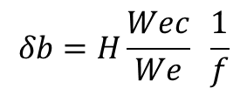

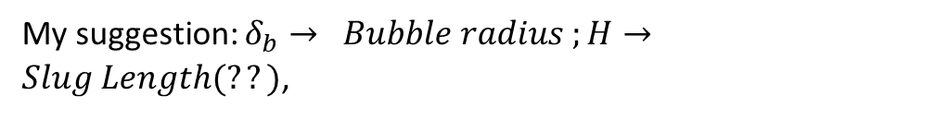
The model: M. Bonizzi, R.I. Issa
International Journal of Multiphase Flow 29 (2003) 1685–1717
Not many such correlations are available in the
literature, and only three could be found.
My suggestion: $δ_{b}→ Bubble radius ;H→Slug Length(??)$,
$${\dot{M}}_{B}=C ρ_{g}\frac{ u_{t}−u_{Lf}}{H } A α_{g}δ_{b}$$
$$δb=H\frac{Wec}{We} \frac{1}{f}$$
where ut represents the velocity of propagation of the front of the slug (see Fig. 4), uLf the velocity of the liquid in the film region, and Si the gas–liquid interfacial width in the film.
$$We={ρ U^{2}H}/σ$$

Slide 8
The model: M. Bonizzi, R.I. Issa
International Journal of Multiphase Flow 29 (2003) 1685–1717
Film and slug front/tail velocities
The alternative method for determining these velocities is to continually track the movements
of each slug front and tail in time and then calculate the velocities simply from the displacement of
these points over successive time steps in the numerical integration.
It is assumed herein that the front and tail of a slug travel at the same velocity. Hence, both slug velocities are
based on the following equation:

Slide 9
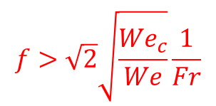
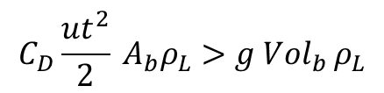
The model: M. Bonizzi, R.I. Issa
International Journal of Multiphase Flow 29 (2003) 1685–1717
Some discussion points:
The model assumes that the aeration will always occur, no matter the slug or gas velocities. In my opinion there will be cases that even though the gas is captured by the slug, it will boil up and will not aerate the slug.
This equation means that only for values of the friction factor higher than some specific limit, the aeration process is effective!?
$$C_{D}\frac{{ut}^{2}}{2} A_{b}ρ_{L}>g {Vol}_{b }ρ_{L}$$
Using the bubble radius definition, we have that the condition
for the bubble to be trapped is:
$$f>\sqrt{2}\sqrt{\frac{{We}_{c}}{We}}\frac{1}{Fr}$$

